Slide 1
What About Revelation 20?
December 12, 2021

Slide 2
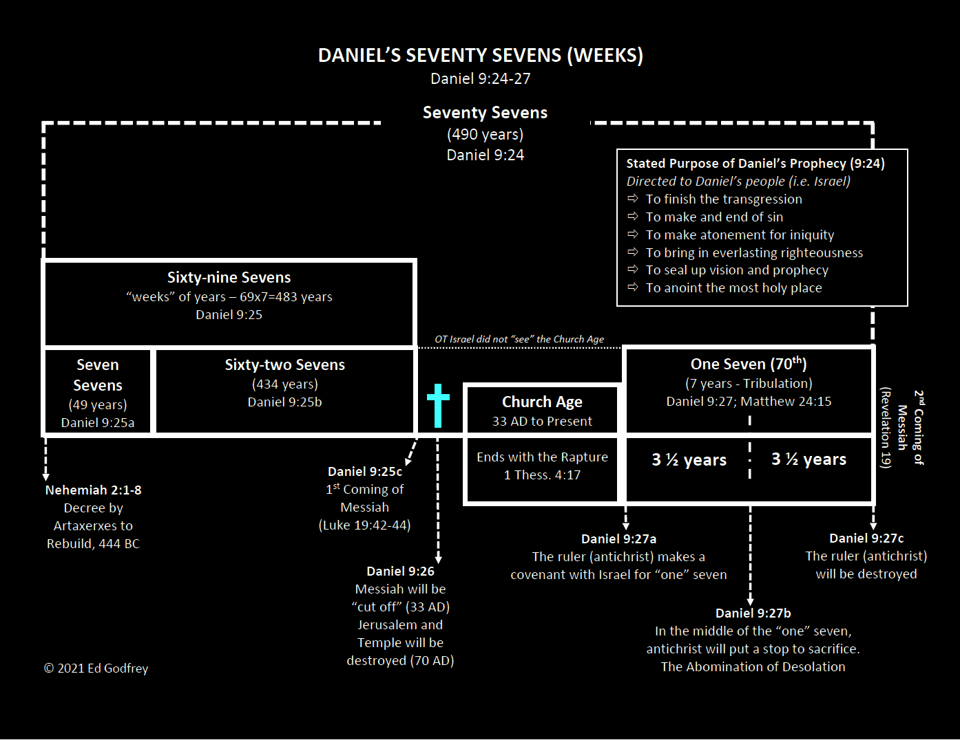
173,880 days

Slide 4
Revelation 20:1-5
1 Then I saw an angel coming down from heaven, holding the key of the abyss and a great chain in his hand. 2 And he laid hold of the dragon, the serpent of old, who is the devil and Satan, and bound him for a thousand years; 3 and he threw him into the abyss, and shut it and sealed it over him, so that he would not deceive the nations any longer, until the thousand years were completed; after these things he must be released for a short time. 4 Then I saw thrones, and they sat on them, and judgment was given to them. And I saw the souls of those who had been beheaded because of their testimony of Jesus and because of the word of God, and those who had not worshiped the beast or his image, and had not received the mark on their forehead and on their hand; and they came to life and reigned with Christ for a thousand years. 5 The rest of the dead did not come to life until the thousand years were completed. This is the first resurrection.

Slide 5
Revelation 20:6-10
6 Blessed and holy is the one who has a part in the first resurrection; over these the second death has no power, but they will be priests of God and of Christ and will reign with Him for a thousand years. 7 When the thousand years are completed, Satan will be released from his prison, 8 and will come out to deceive the nations which are in the four corners of the earth, Gog and Magog, to gather them together for the war; the number of them is like the sand of the seashore. 9 And they came up on the broad plain of the earth and surrounded the camp of the saints and the beloved city, and fire came down from heaven and devoured them. 10 And the devil who deceived them was thrown into the lake of fire and brimstone, where the beast and the false prophet are also; and they will be tormented day and night forever and ever.

Slide 6
Revelation 20:11-15
11 Then I saw a great white throne and Him who sat upon it, from whose presence earth and heaven fled away, and no place was found for them. 12 And I saw the dead, the great and the small, standing before the throne, and books were opened; and another book was opened, which is the book of life; and the dead were judged from the things which were written in the books, according to their deeds. 13 And the sea gave up the dead which were in it, and death and Hades gave up the dead which were in them; and they were judged, every one of them according to their deeds. 14 Then death and Hades were thrown into the lake of fire. This is the second death, the lake of fire. 15 And if anyone's name was not found written in the book of life, he was thrown into the lake of fire.

Slide 7
Revelation 20 (one of John’s visions of what is to come)
This passage describes a thousand-year period of time when:
Satan will be bound in the abyss (vv. 1-3) and
Christ will reign upon the earth (vv. 4-6).

Slide 8
A key difference in millennial views:
The key difference is that Amillennialism, and Postmillennialism affirm that the thousand years of Revelation 20 is present, whereas Futuristic Premillennialsm maintains it is future.

Slide 9
What about Revelation 20?
We are going to examine several key features in Revelation 20 to demonstrate that it clearly teaches that the thousand year reign of Christ will take place after His second coming (Revelation 19). We are going to do this under the framework of four main questions:
The timing of Satan’s binding. Is it now or future?
The nature of the first resurrection. Is it physical or spiritual?
The duration of the thousand years. It is a literal or symbolic period of time? And,
The chronology of John’s visions. Sequential or a recapitulation?

Slide 10
The Duration of the “Thousand Years”
Amillennialists, and Postmillennialists generally say that, in keeping with the symbolic nature of Revelation as a whole, the “thousand years” should be understood symbolically, representing a “complete” period of time or an indefinitely long period of time.
The main argument for the symbolic view is that the book of Revelation is full of symbolism in general and symbolic numbers in particular.
We cannot merely “say” that Revelation is filled with symbolism and therefore the thousand years must be symbolic.

Slide 11
The Duration of the “Thousand Years”
Three considerations:
Does the passage possess a degree of absurdity if taken literally?
Does the passage possess a degree of clarity if taken symbolically?
Does the passage fall into an established category of symbolic language?

Slide 12
Isaiah 55:12 (Symbolic or Literal?)
For you will go out with joy And be led forth with peace; The mountains and the hills will break forth into shouts of joy before you, And all the trees of the field will clap their hands.

Slide 13
The Duration of the “Thousand Years”
Three considerations:
Does the passage possess a degree of absurdity if taken literally?
Does the passage possess a degree of clarity if taken symbolically?
Does the passage fall into an established category of symbolic language?

Slide 14
The Chronology of John’s Vision
Heart of the debate - The timing of the millennium is ultimately found in the chronological relationship of Revelation 19 and Revelation 20.
Most interpreters agree that the Revelation 19:11-21 visions portray the second coming
If the visions of Revelation 20:1-6 portray what happens next - after the second coming – then obviously the thousand years are yet future and we are left with Premillennialsm.

Slide 15
The Chronology of John’s Vision
Amillennialism, and Postmillennialism contend that Revelation 19 and 20 recapitulates the same events.
Recapitulation view, sees parallels between the casting down of Satan in Revelation 12:7-12 and the casting down of Satan in Revelation 20:1-6.
Both take place in a heavenly scene, both involve an angelic battle, both refer to him as the dragon and the ancient serpent, both portray him as being cast down, and both refer to his “short” period of time.

Slide 16
The Chronology of John’s Vision
Some differences
In Revelation 12 Satan is cast down from heaven to earth while in Revelation 20 he is cast down from earth into the abyss
The casting down of chapter 12, results in the increased deception of the nations (13:14; 16:14; 18:23; 19:20). While the casting into the abyss in Rev. 20, prevents him from deceiving
In Revelation 12 Satan is cast down to the earth for a short time, but in Revelation 20 he is cast into the abyss for a long time (the thousand years) and then released for a short time.
If the recapitulation view is correct, the short time in Revelation 12 coincides with the long time in Revelation 20 which is then followed by a short time.

Slide 17
The Chronology of John’s Vision
We see the progression of Revelation 12 through 19 sequentially in which the events of Revelation 20 follow those of chapter 19
Notice phrasing of vs. 3 “and he threw him into the abyss, and shut it and sealed it over him, so that he would not deceive the nations any longer.”
The description of the lake of fire in Revelation 19:20; 20:10.
At the time of the second coming, prior to the thousand years, the beast and the false prophet will be “thrown alive into the lake of fire which burns with brimstone (19:20).”
At the conclusion of the thousand years, Satan will be “thrown into the lake of fire and brimstone, where the beast and the false prophet are also (20:10).”

Slide 18
The Chronology of John’s Vision
The sequence of events in Revelation 19-20
The beast and false prophet are thrown into the lake of fire in 19:20, then
Satan is bound and sealed in the abyss for a thousand years (20:1-6), then,
Satan is released after the thousand years and defeated by fire from heaven (20:7-9), then
Satan is thrown into the lake of fire where the beast and the false prophet already are (20:10).

Slide 19
The Chronology of John’s Vision
When Christ returns to the earth in glory:
Satan will be cast into the abyss where he will be confined for a thousand years.
During this time the Lord Jesus will establish His millennial kingdom and reign from Jerusalem in perfect peace and righteousness.
Then, at the conclusion of the thousand years, Satan will be released from the abyss, decisively defeated, and thrown into the lake of fire.
The wicked will be judged, the earth will be destroyed, and a new heaven and earth will be established and continue throughout eternity.
And in this way, when all is said and done, the Lord Jesus Christ will be victorious over all that is evil.

Slide 20
What About Revelation 20?
December 12, 2021

